Slide 1
82C55
Programmable Peripheral Interface

Slide 2
About 82C55
The 82C55 is a popular low cost interfacing component, that can interface any TTL-compatible I/O device to a microprocessor.
It is used to interface to the keyboard and a parallel printer port in PCs (usually as part of an integrated chipset).

Slide 3
About 82C55
PPI has 24 pins for I/O that are programmable in groups of 12 pins and has three distinct modes of operation.

Slide 4
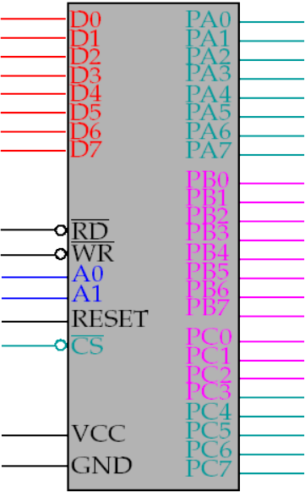
82C55 : Pin Layout
Group : A Port (A0-A7) & Upper part of port C (C4-C7)
Data bus
Port A
Input pin
Port B
Reset all program
Port C
Group : B Port (B0-B7) & Lower part of port C (C0-C3)
Programming,reading & writing to a port

Slide 5
82C55
Control Signals:
RD
WR
Read/write
Control
Logic
A0
A1
Reset
CS

Slide 6
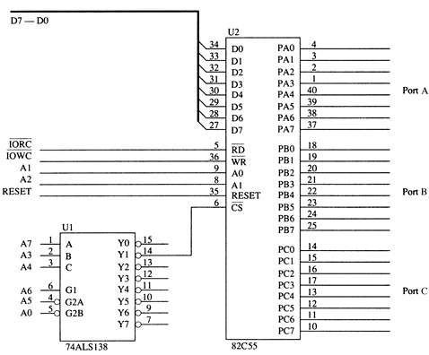
Figure 11–19 The 82C55 interfaced to the low bank of the 80386SX microprocessor.

Slide 7
A RESET input to the 82C55 initializes the device whenever the microprocessor is reset.
A RESET input to the 82C55 causes all ports to be set up as simple input ports using mode 0 operation.

Slide 8
82C55 PPI
Addressing the 82C55
A1 A0 = 00 Port A ;
= 01 Port B ;
= 10 Port C ;
= 11 Command Register;

Slide 9
Programming The 82C55
82C55 contains only two internal Command Registers
Notice that bit position 7 selects either Command byte A or Command byte B.
Command byte A : (command byte A programs the function of group A and B)
Command byte B : (command byte b sets (1) or reset (0) bit of port C only if the 82C55 is programmed in mode 1 & 2)

Slide 10
Programming The 82C55
Group B Pins:
Are programmed as either input or output pins.Group B can operate in either mode o or 1.
Mode 0 is the basic input/output mode that allows pins of group B to be programmed as simple input latched output connections.
Mode 1 operation is the strobed operation for group B connections.

Slide 11
Programming The 82C55
Group A Pins:
Are also programmed as either input or output pins.The difference is that Group A can operate in modes 0,1 and 2.
82C55 has three operation modes:
mode 0
mode 1
mode 2

Slide 12
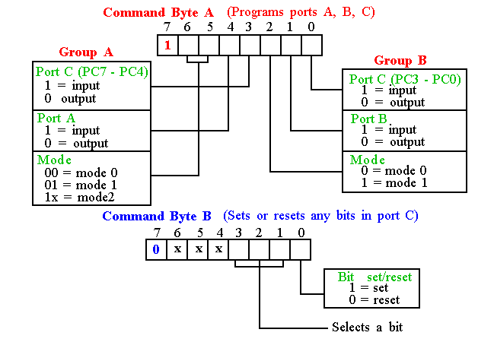
Programming 82C55

Slide 13
Mode 0 (Basic Input/Output).
This functional configuration provides simple input and output operations for each of the three ports.
No “handshaking” is required, data is simply written to or read from a specified port.

Slide 14
MODE 1 (Strobed Input/Output)
This functional configuration provides a means for transferring I/O data to or from a specified port in conjunction with strobes or “handshaking” signals.
In mode 1, Port A and Port B use the lines on Port C to generate or accept these “handshaking” signals

Slide 15
Mode 1 Basic functional Definitions
Two Groups (Group A and Group B).
Each group contains one 8-bit data port and one 4-bit control/data port.
The 8-bit data port can be either input or output Both inputs and outputs are latched.
The 4-bit port is used for control and status of the 8-bit data port.

Slide 16
MODE 2 Basic Functional Definitions:
Used in Group A only.
One 8-bit, bi-directional bus port (Port A) and a 5-bit control port (Port C).
Both inputs and outputs are latched.
The 5-bit control port (Port C) is used for control and status for the 8-bit, bi-directional bus port (Port A).

Slide 17
A Stepper Motor Interfaced to the 82C55.
Another device often interfaced to a computer system is the stepper motor.
  a digital motor because it is moved in discrete steps as it traverses through 360°
An inexpensive stepper motor is geared to move perhaps 15° per step
A more costly, high-precision stepper motor can be geared to 1° per step.

Slide 18
A Stepper Motor Interfaced to the 82C55.
In all cases, these steps are gained through many magnetic poles and/or gearing.
Figure 11–23 shows a four-coil stepper motor that uses an armature with a single pole.
  two coils are energized
If less power is required, one coil may be energized at a time, causing the motor to
step at 45°, 135°, 225°, and 315°.
The motor is shown with the armature rotated to four discrete places, called full stepping.
  accomplished by energizing the coils, as shown

Slide 19
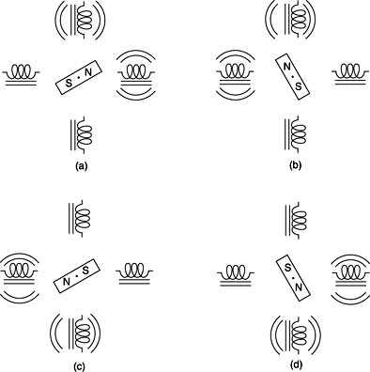
Figure 11–23 The stepper motor showing full-step operation: (a) 45° (b) 135° (c) 225° (d) 315°.

Slide 20
A Stepper Motor Interfaced to the 82C55.
    The motor is driven by NPN Darlington amp pairs to provide a large current to each coil.
    A circuit that can drive this stepper motor is illustrated in Fig 11–24.
    with the four coils shown in place
    This circuit uses the 82C55 to provide drive signals used to rotate the motor armature in either the right- or left-hand direction.

Slide 21
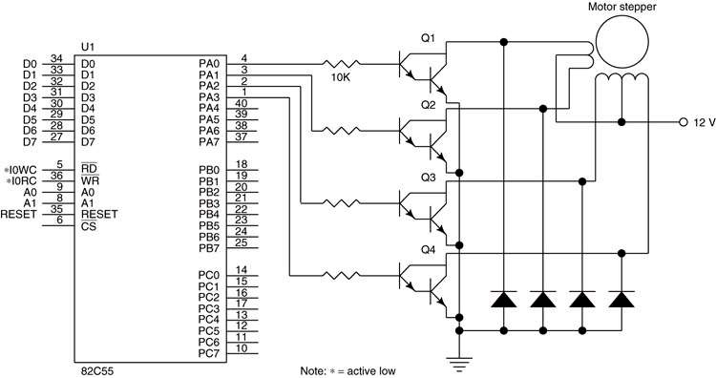
Figure 11–24 A stepper motor interfaced to the 82C55. This illustration does not show the decoder.

Slide 22
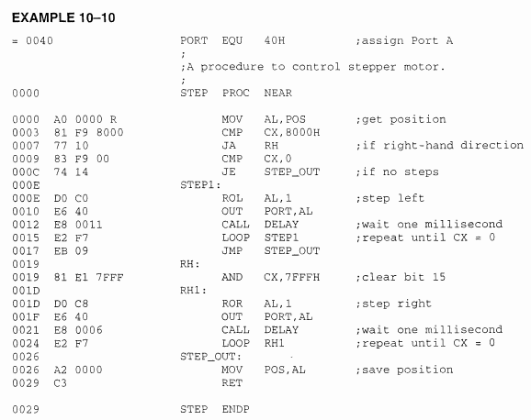
A Stepper Motor Interfaced to the 82C55.
    From subroutine of Ex 10-10, CX contain the direction and steps of rotation.
      If CX>8000h, motor spins in right hand direction
      If CX<8000h, motor spins in left hand direction
      The 15 bits except MSL(leftmost bit) express the no. of steps.

